Slide 1

Department of Information Science
Data Evaluation and Improvement for Machine Learning
Haihua Chen, Ph.D.
https://iia.ci.unt.edu/haihua-chen
haihua.chen@unt.edu
Sep 18, 2024

Slide 2
Content:
Background
Statement of The Problem
Purpose of The Study
Definitions
Research Questions
Outline of The Study
Literature Review
Methodology
Domain-specific Machine Learning Dataset Construction and Quality Evaluation
Data Quality Improvement for Performance Enhancement of Machine Learning
Conclusion and Future Work
References
Acknowledgement

Slide 3


Background
The determinants of AI success
Data
ML models/algorithms
The widely applications of ML and DL
AlphaGo
Amazon Alexa
Chatbots
Autopiloting

Slide 4
Background (Cont.)
AI researchers and practitioners overwhelmingly concentrate on models/algorithms, while undervalue the data quality. (Sambasivan et al., 2021)
Garbage in, garbage out
Ex.1: 0.8% error rate for recognizing the faces of lighter-skinned males, but as high as 34.% error rate for recognizing the faces of darker-skinned females. (Buolamwini et al., 2018)
Ex.2: IBM’s cancer treatment AI accuracy reduced. (Strickland et al., 2019)
Ex.3: Google Flu Trends missing the flu peak by 140%. (Kandula and Shaman, 2019)
Data quality for machine learning has not been properly and systematically validated.
There are no “one-size-fits-all” solutions for data quality evaluation and improvement.

Slide 5
Statement of the Problem
Data quality is essential for machine learning, nevertheless it has not been
rigorously evaluated.

Slide 6
Purpose of the Study
We aim to explore how to construct high-quality datasets, evaluate and
improve the data quality for domain-specific machine learning systems.

Slide 7
Definitions
Definition of Concepts
Data quality
Measure the quantitative and qualitative properties of data.
Data that are fit for use by data consumers. (Wang and Strong, 1996)
The capability of the data for “fit for purpose” of building a machine learning system. (Chen et al., 2021)
Data quality problems: a set of issues that can affect the potentiality of the applications that use the data
Lacking enough training data
Invalid data and label noises
Significant imbalanced training data
Duplication
. . .

Slide 8
Definitions (Cont.)
Definition of Concepts
High-quality data (“good data”)
“Fit for purpose” of applications.
Four basic standards for high-quality data in machine learning defined by Andrew: defined consistently, cover of important cases, has timely feedback from production data, and sized appropriately. (Andrew, 2021)
Data quality dimensions: a set of data quality attributes that represent a single aspect or construct of data quality (Wang and Strong, 1996)
Comprehensiveness
Correctness
Variety
Completeness
Timeliness
. . .

Slide 9
Definitions (Cont.)
Definition of Concepts
Data quality evaluation (“data quality assessment”)
How to evaluate each data quality dimension. (Cai et al., 2015)
Qualitatively method: performed by subject experts or professionals.
Quantitatively method: a formal, objective, and systematic process in which numerical data are utilized to obtain information.
Data quality evaluation results offer guidelines of data quality improvement.
Data quality improvement
Detect and remove errors, inconsistencies, and other data quality issues.
Data quality can be improved systematically and iteratively. (Andrew, 2021)

Slide 10
Research Questions
RQ1: How to construct a high-quality, domain-specific, and large-scale machine learning corpus using semi-automatic approaches?
RQ2: How to systematically evaluate the data quality for machine learning?
RQ3: What are the techniques that can be used to improve the data quality?
RQ4: What are the best practice of implementing machine learning techniques for data quality improvement?

Slide 11
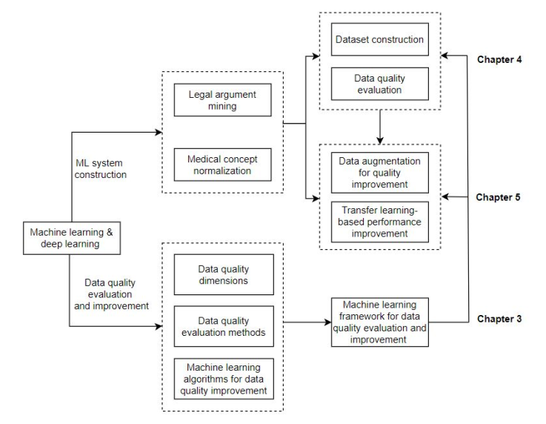
Outline of The Study
Figure 1: Outline of this study.

Slide 12
Literature Review
Overview
Data Quality
Data Quality for ML
Data Quality Improvement Techniques
Domain Text Classification
Machine Learning Model Selection

Slide 13
Literature Review - Data Quality
Summary of existing data quality evaluation frameworks
Wang et al. (1996); intrinsic, contextual, representational, accessibility; 15 metrics
Bovee et al. (2003); credibility, accessibility, interpretability, relevance; 9 metrics
Price et al. (2005); syntactic, semantic, pragmatic; 13 metrics
Stvilia et al. (2007); intrinsic, representational, relational; 22 metrics
Arazy et al. (2010); intrinsic, contextual, representational; 4 metrics
Cai et al. (2015); availability, usability, reliability, relevance, presentation quality; 14 metrics
Zaveri et al. (2016); accessibility, intrinsic, trust, dataset dynamicity, contextual, representational; 22 sub-dimensions and 97 metrics
Chen et al. (2019); intrinsic, contextual, representational, accessibility; 18 metrics
. . .

Slide 14
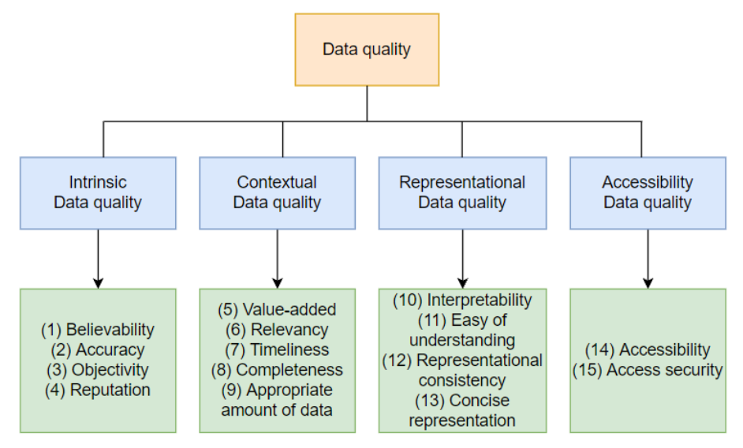
Literature Review - Data Quality
Figure 2: A conceptual framework of data quality.
It has been reused by many recent data quality studies. Meanwhile, modification
is made to fit the DQ framework into different purposes.

Slide 15
Literature Review - Data Quality for ML
Data quality largely determines the performance, fairness, robustness, safety, and scalability of ML and AI systems. (Sambasivan et al. 2021)
Identify the data quality issues such as data errors and missing values in data mining and machine learning. (Hulse, 2007)
How many percentages of label noise can affect the ML performance? (Lauria and Tayi, 2008)
Trustworthiness or reliability is another critical data quality dimension of machine learning. (Dong, 2015)
How do different data quality features impact machine learning systems. (Foidl and Felderer, 2019)
A system for automating the verification of the data quality of large-scare data, aiming to fit the purpose for business and decision making. (Schelter et al., 2018)
Insufficient training data has become a common data quality issue for machine learning. (Lourentzou, 2019)
Other data quality issues: duplication, highly correlated variables, large number of variables, outliers, data source bias, etc. (Gudivada et al., 2017)

Slide 16
Literature Review - Data Quality for ML
Status of Data Quality Research for ML
Improving data quality as “operational” vs building novel models and algorithms. (Sambasivan et al., 2021)
Improving the data might be more effective than improving the model. (Andrew, 2021)
Tutorials related to data quality in ML and DL. (Jain et al., 2020; Whang and Lee, 2020)
Research Gap
Data quality of ML has not been appropriately validated.
Discussions on the impact of data quality on the ML performance with evidence and measurement is rare.
Improving the ML performance by improving data quality instead of model construction deserves more attention.

Slide 17
Literature Review - Data Quality Improvement
Semi-supervised Learning (Van Engelen and Hoos, 2020)
Co-training (Aridas and Kotsiantis, 2015)
Active Learning (Lourentzou, 2019)
Expectation-maximization (Liu et al., 2003; Brefeld and Scheffer, 2004; Chokka and Rani, 2020)
Generative Adversarial Learning (Goodfellow et al., 2014; Croce et al., 2020)
Transfer Learning (Zhuang et al., 2020)
Few-shot Learning (Wang et al., 2020)

Slide 18
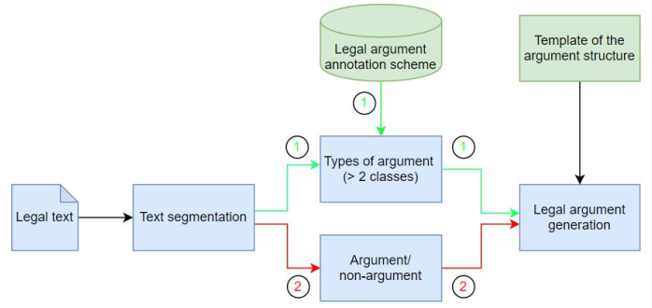
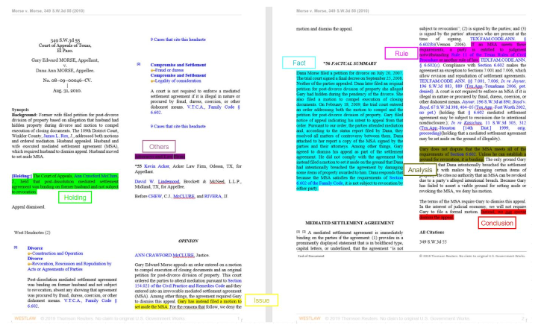
Literature Review - Domain-specific Text Classification
Legal Argument Mining
Argument/non-argument detection for different text types, multinomial NB (Moens et al., 2007).
Legal argumentation structure detection, SVM (Palau et al., 2009).
Argument classification, five categories, C4.5 decision tree (Feng and Hirst, 2011).
Argument extraction for legal information retrieval, six categories, a theoretical discussion (Ashley, 2014).
Five years of argument mining, literature review (Cabrio and Villata, 2018).
Argument mining: a survey (comprehensive) (Lawrence and Reed, 2019).
Predict charges for legal judgment, four categories (Le et al., 2020)
Figure 3: The pipeline of legal argument mining (top) and the Legal Arguments in a Legal Case (bottom).

Slide 19
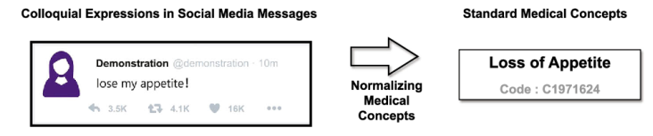
Literature Review - Domain-specific Text Classification
Medical Concept Normalization
Arizona Disease Corpus (AZDC); with/without rule-based NLP module (Kang et al., 2013).
The NCBI disease corpus; pairwise learning to rank (Leaman et al., 2013).
TwADR-S, TwADR-L, and AskAPatient; CNN and RNN (Limsopatham and Collier, 2016).
TwADR-L and AskAPatient; CNN and RNN (Lee et al, 2017).
ShARe/CLEF eHealth dataset and the NCBI disease dataset; handcrafted rules with CNN model (Li et al, 2017).
TwADR-L, AskAPatient, and ChMCN; multi-task character-level attentional network (Niu et al., 2019).
CADEC corpus and PsyTAR corpus; Text embedding and graph embedding (Pattisapu et al., 2020).
CADEC-MCN and TwADR-L; BertForSequenceClassification and BERT+Highway Network (Kalyan et al., 2021).
Figure 4: Medical Concept Normalization (Niu et at., 2019)

Slide 20
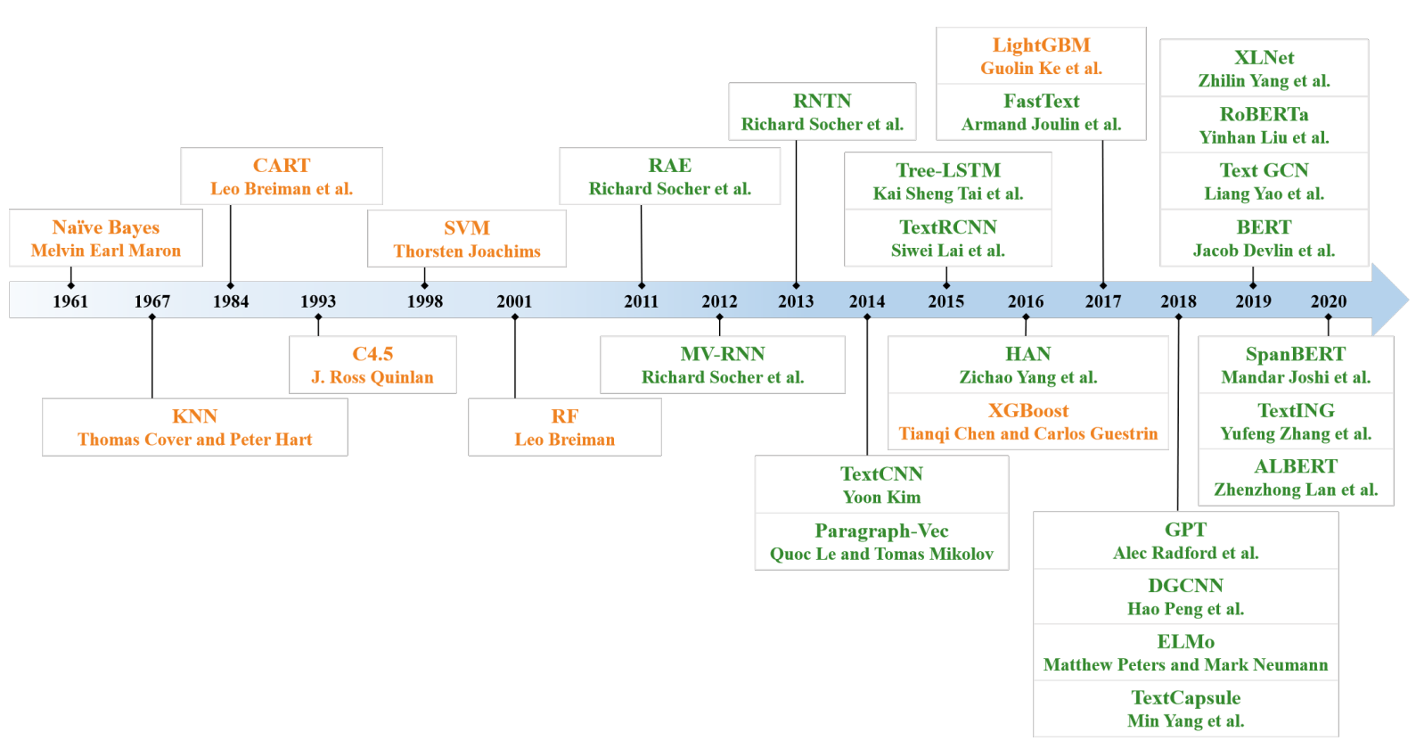
Literature Review - Model Selection for ML
Figure 5: Existing machine learning models organized by timeline (Li at al., 2020).

Slide 21
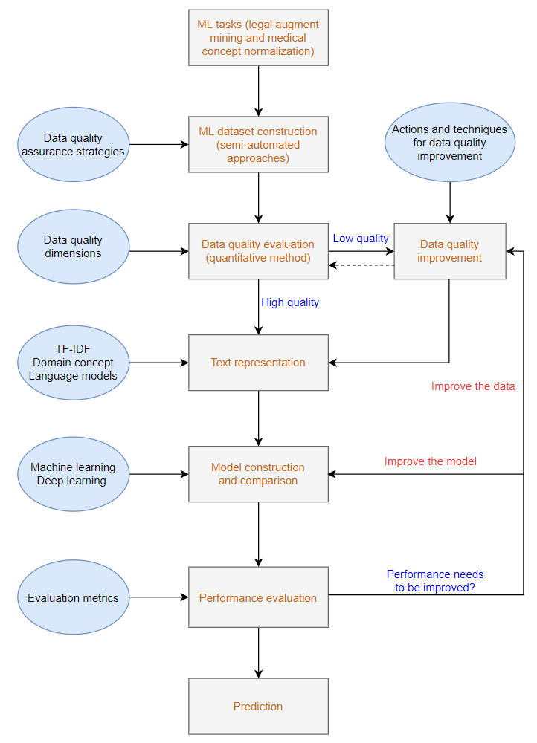
Methodology – Framework of ML System Construction
Figure 6: Machine learning lifecycle by considering data evaluation and model construction

Slide 22
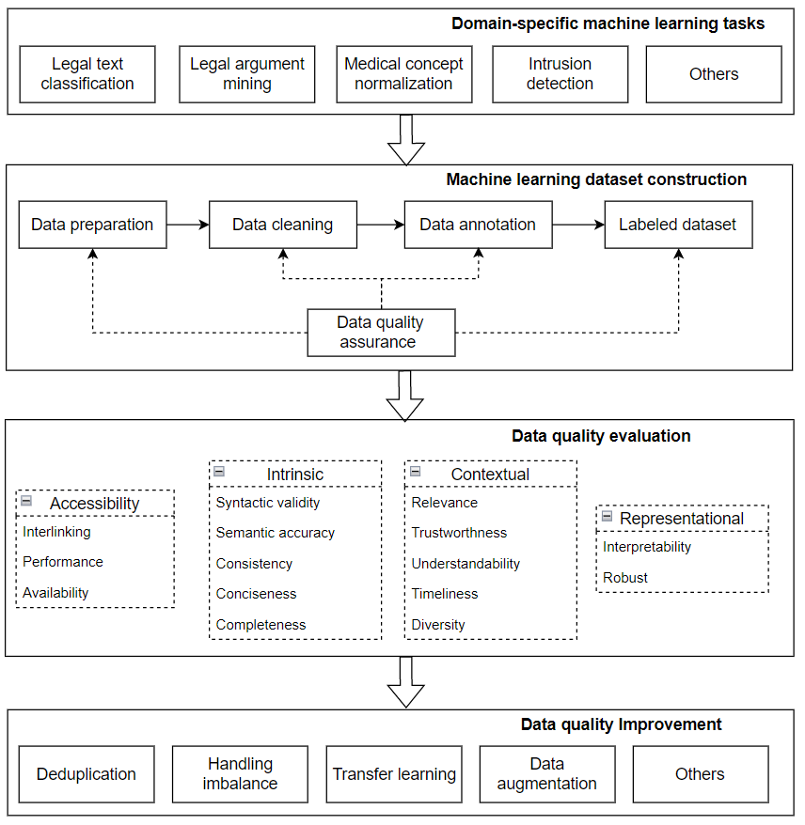
Methodology – Framework of Data Quality Evaluation and Improvement
Figure 7: Data quality evaluation and improvement framework for machine learning

Slide 23
Methodology - Task Description
Medical concept normalization
Legal argument mining
Figure 7: Machine learning tasks in this study (left: legal argument mining, right: medical concept normalization)

Slide 24
Methodology – Data Quality Evaluation
Data Quality Dimensions
Comprehensiveness
Correctness
Duplication
Class imbalance
Data Quality Evaluation Approaches
Quantitative methods
Statistical analysis
Experimental study

Slide 25
Methodology - Algorithms
List of Algorithms
Text Representation
Text Classification Algorithms
Handling Class Imbalance
Data Augmentation
Transfer Learning

Slide 26
Methodology – Algorithms (Cont.)
Text Representation
TF-IDF
ULMFit
BERT
Text Classification Algorithms
Random forests
Support vector machine
Light gradient boosting machine
RNN
BERT

Slide 27
Methodology - Algorithms (Cont.)
Handling Class Imbalance
Over-sampling
Down-sampling
Synthetic Minority Oversampling Technique (SMOTE)
Down-sampling + over-sampling + SMOTE (Mixed-sampling)
Data Augmentation
Pseudo-labeling
Co-training
Expectation-maximization
Generative adversarial network
Transfer Learning
Fine-tuning Task-specific Machine Learning Model
Fine-tuning Language Model

Slide 28
Methodology – Performance Evaluation
Evaluation Metrics for Machine Learning Performance
Accuracy
Precision
Recall
F1-score

Slide 29
Domain-specific Machine Learning Dataset Construction and Quality Evaluation
Data Collection
Data Collection for Legal Argument Mining
Data source
Initial data: Harvard Law Library case law corpus.
Data used in this research: 27,712 criminal cases from 1840 to 2018 in Texas (JSON format)
Data cleaning
LexNLP for sentence splitting.
Feature-based ML for invalid sentences removing (0.9158 in accuracy).
542,763 validated sentences for annotation and data augmentation.
Data Collection for Medical Concept Normalization
Datasets for Constructing Machine Learning Systems for MCN
Dataset TwADR-L
Dataset AskAPatient
Datasets for Transfer Learning for Quality Improvement
Cadec dataset, Pubmed dataset, Healthnews dataset, Big tweet dataset

Slide 30
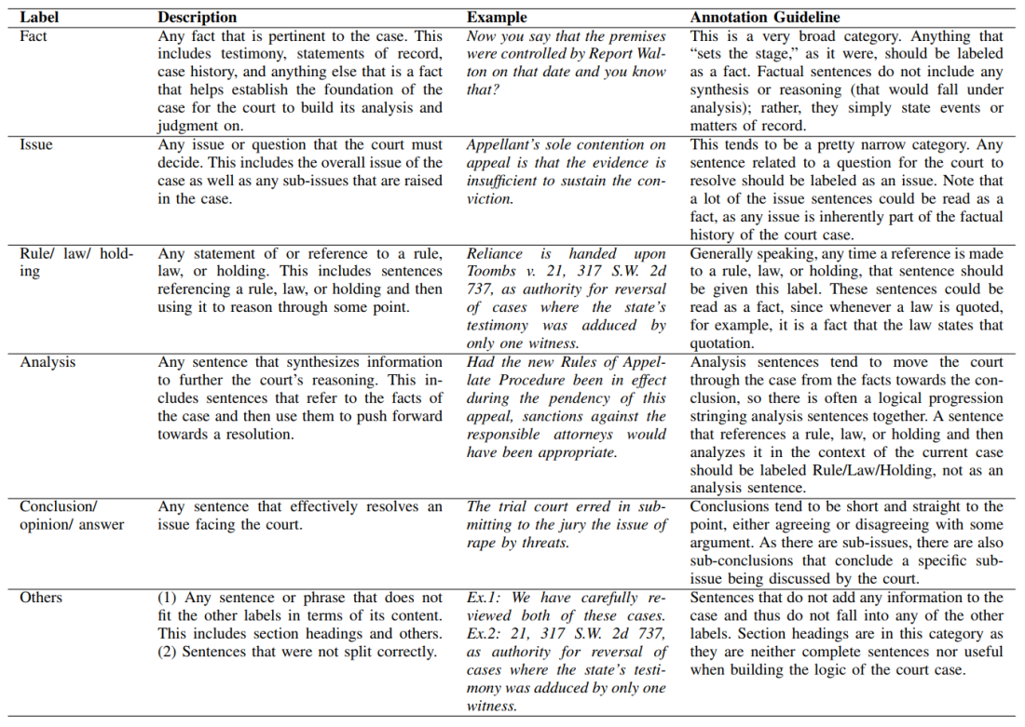
Domain-specific Machine Learning Dataset Construction and Quality Evaluation - Legal
Legal Argument Mining Dataset Construction
Table 1: Annotation Scheme for Legal Argument

Slide 31
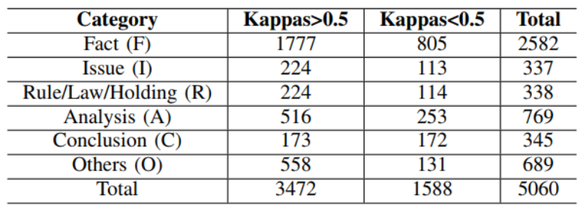
Domain-specific Machine Learning Dataset Construction and Quality Evaluation - Legal
Legal Argument Mining Dataset Construction
Human annotation
An annotation scheme for legal argument
Annotation tool: doccano
Annotation procedure
Inter-agreement evaluation: Kappa value
Quality assurance of the annotation
Table 2: Summary of the dataset from the annotation

Slide 32
Domain-specific Machine Learning Dataset Construction and Quality Evaluation
Data quality evaluation – Experiment design
Experiments on annotation quality evaluation to check the correctness of the labeling. (Legal)
Experiments to investigate the data sufficiency to check the comprehensiveness of the data. (Legal)
Experiments to investigate the class imbalance issue of the dataset. (Legal)
Experiments to investigate the overclaimed performance issue of the medical concept normalization system due to the duplication in the datasets. (Medical)

Slide 33
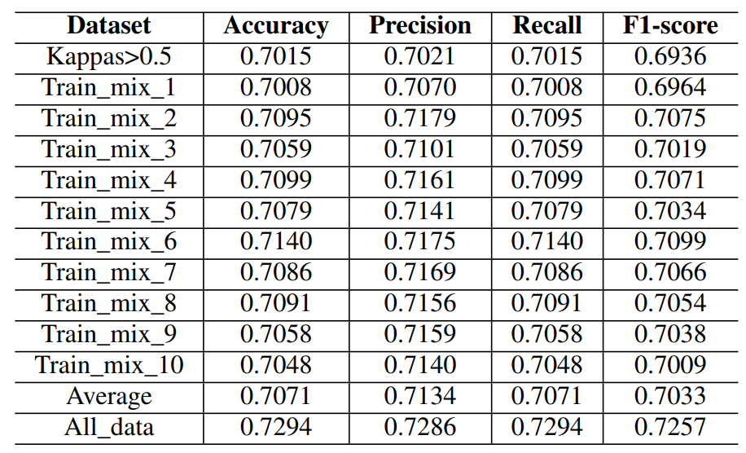
Domain-specific Machine Learning Dataset Construction and Quality Evaluation (Cont.)
Data quality evaluation - Experiment Results
Results on Correctness Evaluation (Legal)
Table 3: Performance on different training datasets using BERT

Slide 34
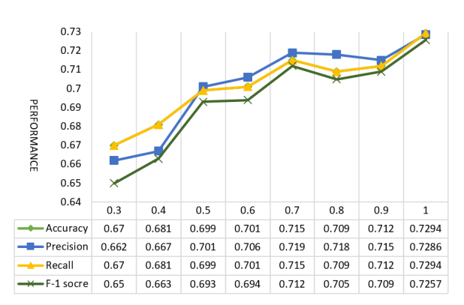
Domain-specific Machine Learning Dataset Construction and Quality Evaluation (Cont.)
Data quality evaluation - Experiment Results
Results on Comprehensiveness Evaluation (Legal)
Figure 8: The performance of BERT Model by using different portions of data for training

Slide 35
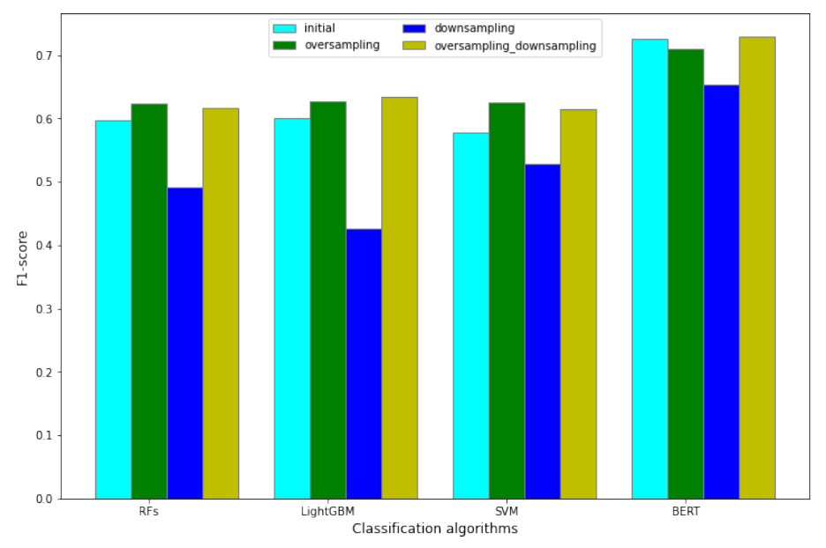
Domain-specific Machine Learning Dataset Construction and Quality Evaluation (Cont.)
Data quality evaluation - Experiment Results
Results on Class Imbalance Evaluation (Legal)
Figure 9: The performance of using different methods to handing class imbalance

Slide 36
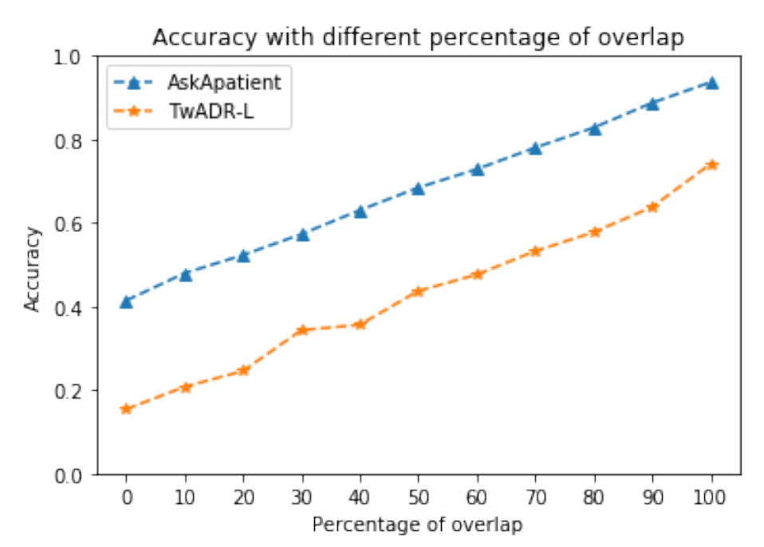
Domain-specific Machine Learning Dataset Construction and Quality Evaluation (Cont.)
Data quality evaluation - Experiment Results
Results on Duplication Evaluation (Medical)
Figure 10: The accuracy of normalizing medical concepts on datasets AskAPatient and TwADR-L with different percentages of overlapped records in the test dataset.

Slide 37
Domain-specific Machine Learning Dataset Construction and Quality Evaluation (Cont.)
Data quality evaluation - Discussion
The commonly used kappa agreement might not be sufficient to judge the annotated data quality, or the labeled correctness.
Incomprehensiveness is another data quality issue of the legal argument mining dataset, which can be detected by using different amount of data for the model training.
There is a trade-off between correctness and comprehensiveness of a dataset for training a high-performance machine learning system.
Many techniques can be applied for handling the data imbalance in text classification. When data is insufficient, over-sampling is a better choice. However, when large categories exist, mixed sampling will be more effective
Tests the model with a different percentage of the duplication between the training and test datasets is an effective approach to understand whether the duplication between training and test data could contribute to the non-exist high performance of a machine learning model

Slide 38
Data Quality Improvement for Performance Enhancement of Machine Learning
Data Quality Improvement Using Data Augmentation - Data Collection (Legal)
4416 annotated sentences for training, 521 sentences for testing, and 542,763 unlabeled sentences were served as the data pool for data augmentation.

Slide 39
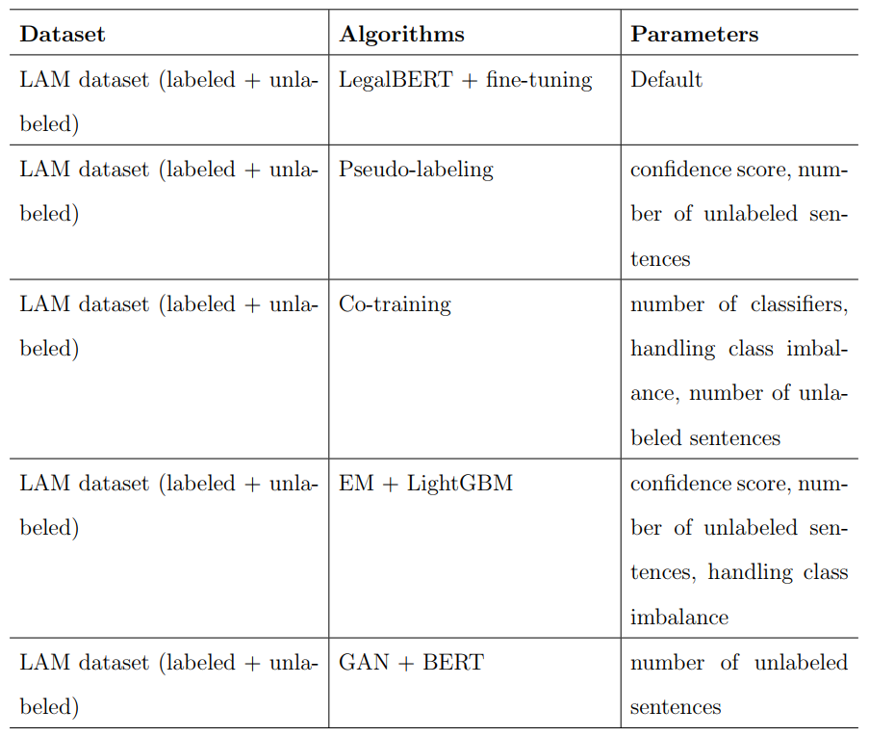
Data Quality Improvement for Performance Enhancement of Machine Learning (Cont.)
Data Quality Improvement Using Data Augmentation -Experiment design (Legal)
Table 4: Experiments design to test the data quality improvement using data augmentation for legal argument mining

Slide 40
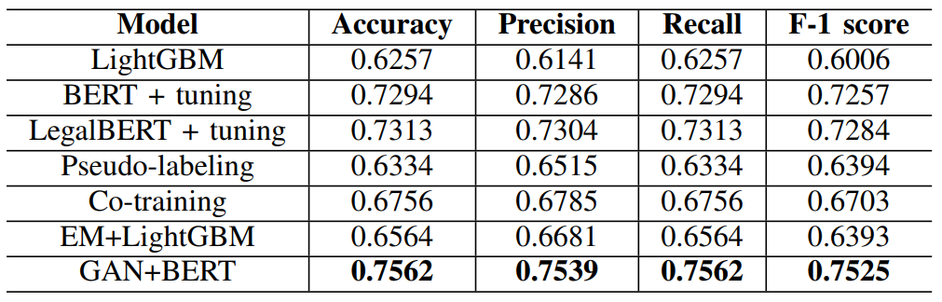
Data Quality Improvement for Performance Enhancement of Machine Learning (Cont.)
Data Quality Improvement Using Data Augmentation - Experiment Results (Legal)
Overall results
GAN + BERT achieved the best performance, followed by LegalBERT and BERT model.
GAN + BERT enjoyed a 0.0268 in F-1 score improvement than the general BERT model.
Deep learning-based models outperform traditional machine learning-based models in the short text classification in the legal domain.
The effectiveness of different data augmentation on performance improvement varies.
Table 5: Performance using different algorithms for data augmentation

Slide 41
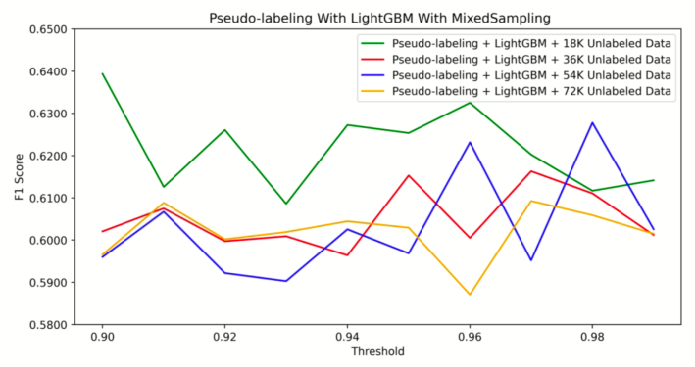
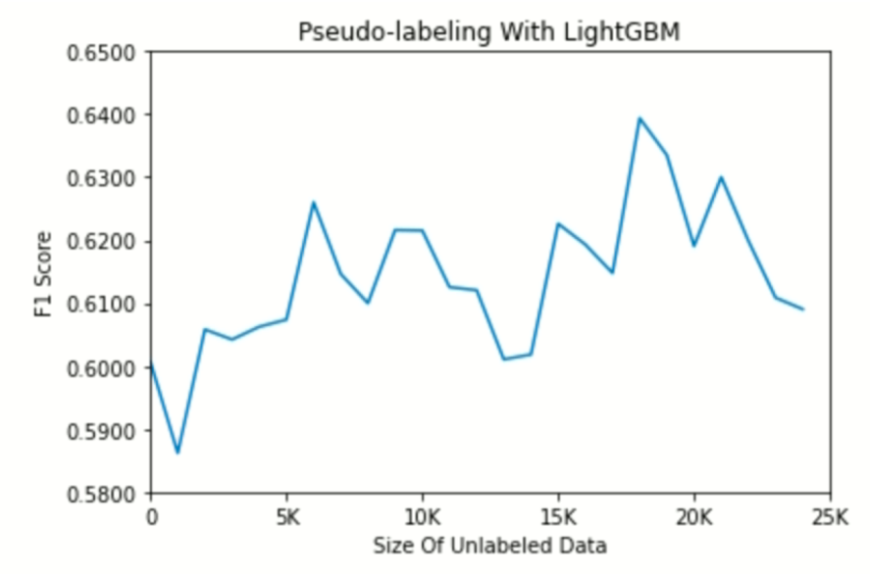
Data Quality Improvement for Performance Enhancement of Machine Learning (Cont.)
Data Quality Improvement Using Data Augmentation - Experiment Results (Legal)
Parameter Analysis - Pseudo-labeling with LightGBM
Figure 11: The performance of pseudo-labeling with different number of unlabeled data (left) and different confidence score (right)

Slide 42
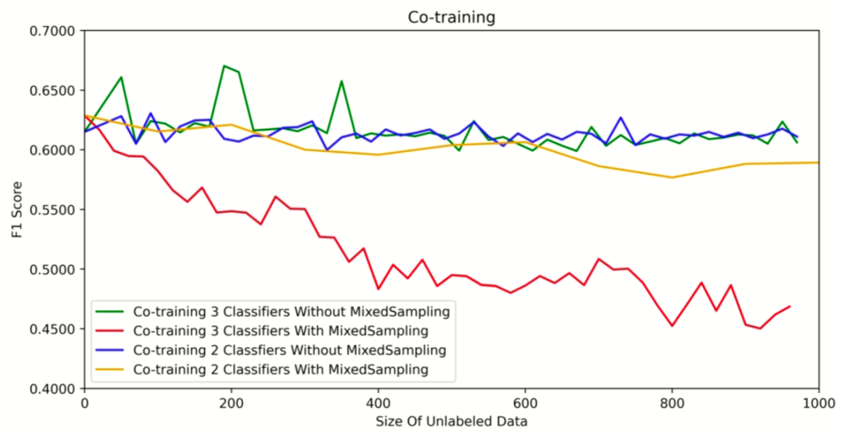
Data Quality Improvement for Performance Enhancement of Machine Learning (Cont.)
Data Quality Improvement Using Data Augmentation - Experiment Results (Legal)
Parameter Analysis - Co-training
Figure 12: The performance of co-training

Slide 43
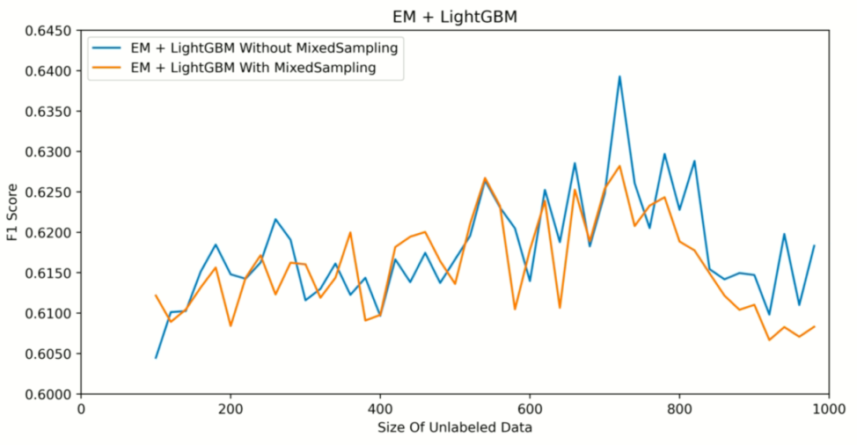
Data Quality Improvement for Performance Enhancement of Machine Learning (Cont.)
Data Quality Improvement Using Data Augmentation - Experiment Results (Legal)
Parameter Analysis - EM with LightGBM
Figure 13: The performance of EM + LightGBM with and without handling class imbalance

Slide 44
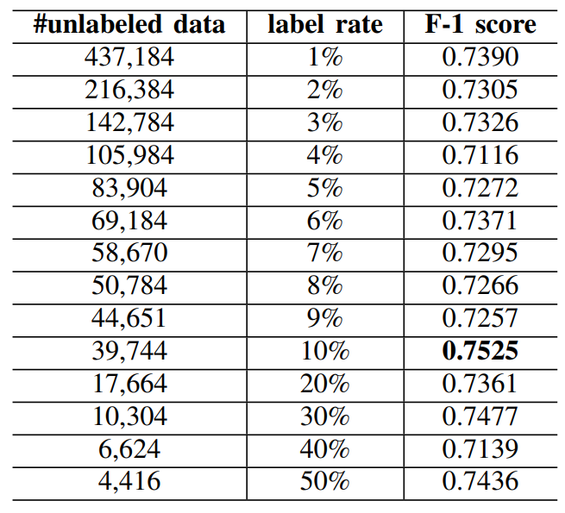
Data Quality Improvement for Performance Enhancement of Machine Learning (Cont.)
Data Quality Improvement Using Data Augmentation - Experiment Results (Legal)
Parameter Analysis - GAN-BERT
Table 6: Performance of GAN-BERT using different number of unlabeled data

Slide 45
Data Quality Improvement for Performance Enhancement of Machine Learning (Cont.)
Data Quality Improvement Using Data Augmentation – Results Discussion (Legal)
When the data quality is not high enough to build a high-performance machine learning system, data augmentation is useful for the performance improvement of the system to be built on the data.
Techniques for handling class imbalance issue that works well for supervised learning are not always effective for semi-supervised learning.
The fine-tuning can be used to improve data quality by taking advantage of the information brought by the source dataset.
GAN can enhance BERT when only few labeled data are available.

Slide 46
Data Quality Improvement for Performance Enhancement of Machine Learning (Cont.)
Data Quality Improvement Based on Transfer Learning- Data Collection (Medical)
TwADR-L and AskAPatient for model training, validation, and testing
Cadec dataset, Pubmed dataset, Healthnews dataset, and Big tweet dataset for fine-tuning.

Slide 47
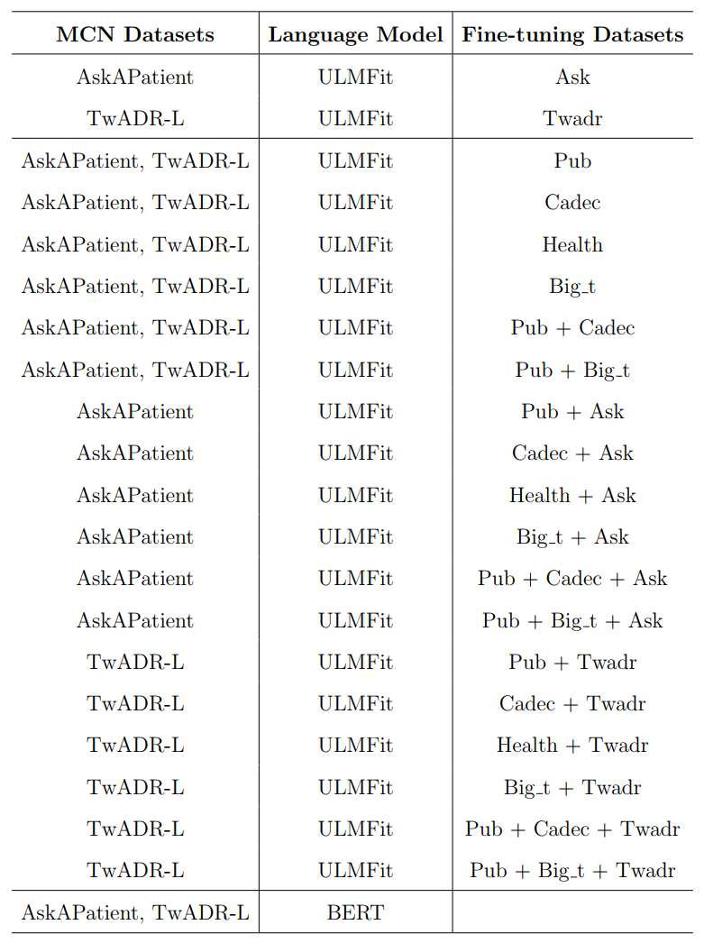
Data Quality Improvement for Performance Enhancement of Machine Learning (Cont.)
Data Quality Improvement Based on Transfer Learning- Experiment design (Medical)
Table 7: The experiment design of transfer learning for data quality and performance improvement

Slide 48
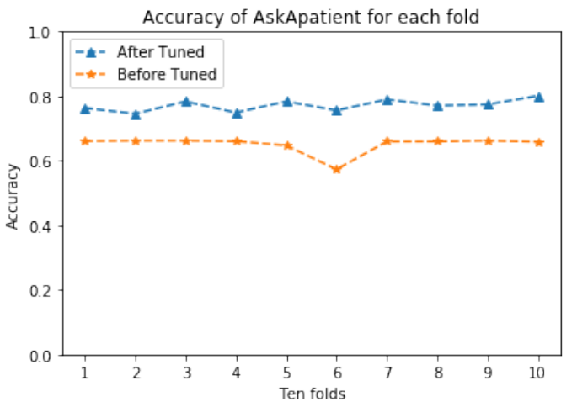
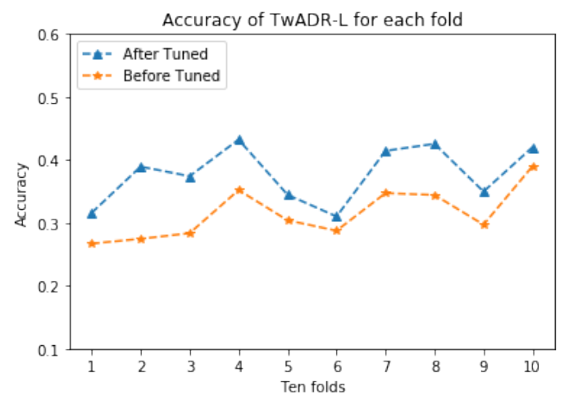
Data Quality Improvement for Performance Enhancement of Machine Learning (Cont.)
Data Quality Improvement Based on Transfer Learning -Experiment Results (Medical)
Fine-tuning with AskAPatient or TwADR-L
Figure 14: An comparison of the accuracy of medical concept normalization that was fine-tuned or was not fine-tuned on datasets AskAPatient (left) and TwADR-L (right)

Slide 49
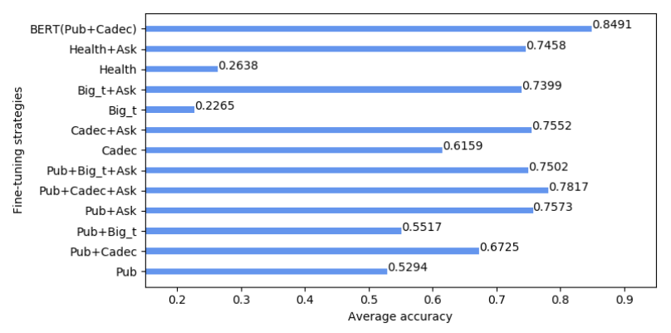
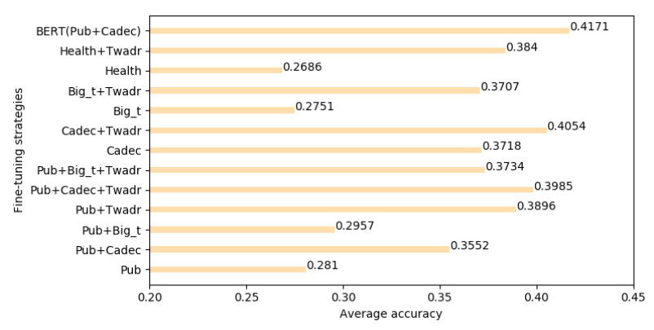
Data Quality Improvement for Performance Enhancement of Machine Learning (Cont.)
Data Quality Improvement Based on Transfer Learning -Experiment Results (Medical)
Fine-tuning with Cadec, Pubmed, Healthnews, Big tweet, and their combinations
Figure 15: The average performance of medical concept normalization that was fine-tuned with different datasets on datasets AskAPatient (left) and TwADR-L (right).

Slide 50
Data Quality Improvement for Performance Enhancement of Machine Learning (Cont.)
Data Quality Improvement Based on Transfer Learning – Results Discussion (Medical)
Fine-tuning the model can increase the accuracy of medical concept normalization on both datasets. It implies that the performance of a model that is trained on poor quality datasets can be improved using well designed fine-tuning.
The datasets for fine-tuning should be related to the target-specific task, otherwise the fine-tuning may produce negative performance impact.
The fine-tuning can be used to improve data quality by taking advantage of the information brought by the source dataset.
A powerful model, such as BERT, can better capture semantic information, thereby can be the prior model for fine-tuning.

Slide 51
Conclusion
RQ1: How to construct a high-quality, domain-specific, and large-scale machine learning corpus using semi-automatic approaches?
Answer:
Semi-automated approaches: a small high-quality initial data was annotated by a human; then, effective data augmentation algorithms were used to expand the size of the dataset.

Slide 52
Conclusion (Cont.)
RQ2: How to systematically evaluate the data quality for machine learning?
Answer:
Systematically and quantitatively evaluate the quality of the dataset based on pre-defined data quality dimensions can help developers to take further actions for the data quality and system improvement.

Slide 53
Conclusion (Cont.)
RQ3: What are the techniques that can be used to improve the data quality?
Answer:
We can choose the GAN-BERT model for data augmentation when a small portion of labeled data while a large portion of unlabeled data is available.
The fine-tuning can be used to improve data quality by taking advantage of the information brought by the source dataset.

Slide 54
Conclusion (Cont.)
RQ4: What are the best practice of implementing machine learning techniques for data quality improvement?
Answer:
The amount of unlabeled data for data augmentation should be carefully selected for training, otherwise the new labeled data may produce negative performance impact.
The datasets for fine-tuning should be related to the target-specific task.
A powerful model, such as BERT, can better capture semantic information, thereby can be the prior model for fine-tuning.

Slide 55
Conclusion – Overall Conclusions
Data quality has a significant impact on the machine learning performance, the impact can be quantitively measured by experimental study.
The data quality evaluation method should be designed based on different applications and different purposes.
Data quality evaluation results can provide guidance for designing experiments for data quality improvement.
Both transfer learning and the data augmentation techniques are not always effective for data quality and system performance improvement. Only carefully designing the experiments and fine-tuning the parameters could produce the desired result.

Slide 56
Future Work
Explore more effective and reusable techniques for constructing domain-specific, high-quality, and large-scale machine learning datasets.
Create and publish several high-quality datasets regarding legal AI, health care, cyber security, recommendation, and others.
Exploring automatic data quality evaluation and improvement approaches regarding different data quality dimensions and applications.
Explore more statistic methods for data quality evaluation.
Develop effective and user-friendly tools for data quality evaluation and improvement for different machine learning applications
Data quality evaluation for graph data such as knowledge graph.
Enhance BERT by combining BERT and external domain knowledge in the attention for domain-specific text classification.
Explore other techniques such as few shot learning for data augmentation.
Others

Slide 57
References (Selected)
Wang, R. Y., & Strong, D. M. (1996). Beyond accuracy: What data quality means to data consumers. Journal of management information systems, 12(4), 5-33.
Andrew Ng, A chat with andrew on mlops: From model-centric to data-centric ai, 2021, [Online; accessed 09-01-2021]
Cai, L., & Zhu, Y. (2015). The challenges of data quality and data quality assessment in the big data era. Data science journal, 14.
Sambasivan, N. et al. (2021, May). “Everyone wants to do the model work, not the data work”: Data Cascades in High-Stakes AI. In proceedings of the 2021 CHI Conference on Human Factors in Computing Systems (pp. 1-15).
Lauria, E. J., & Tayi, G. K. (2008). Statistical machine learning for network intrusion detection: a data quality perspective. International Journal of Services Sciences, 1(2), 179-195.
Dong, X. et al. (2015). Knowledge-Based Trust: Estimating the Trustworthiness of Web Sources. Proceedings of the VLDB Endowment, 8(9).
Lourentzou, I. (2019). Data quality in the deep learning era: Active semi-supervised learning and text normalization for natural language understanding. Doctoral dissertation, University of Illinois at Urbana-Champaign.
Jain, A. et al. (2020, August). Overview and importance of data quality for machine learning tasks. In Proceedings of the 26th ACM SIGKDD International Conference on Knowledge Discovery & Data Mining (pp. 3561-3562).
Li, Q. et al. (2020). A survey on text classification: From shallow to deep learning. arXiv preprint arXiv:2008.00364.
Limsopatham, N., & Collier, N. (2016). Normalising Medical Concepts in Social Media Texts by Learning Semantic Representation. In Proceedings of the 54th ACL Meeting (Volume 1: Long Papers) (pp. 1014-1023).

Slide 58
Thank you! Question?

